Slide 1

SOLELY FOR THE PURPOSE OF FORAGE WORK EXPERIENCES
WEB SCRAPPING TO GAIN COMPANY INSIGHTS
SHUBHIKA RANJAN
24 JAN 2024

Slide 2
Brief about the task
Our goal was to gather and analyze reviews about the airline from Skytrax.
We focused on collecting data and preparing it for analysis.
Visit [https://www.airlinequality.com](https://www.airlinequality.com)
We used Python and BeautifulSoup for scraping, collecting 3740 reviews from 40 pages. (number of pages can be identified by the user)

Slide 3
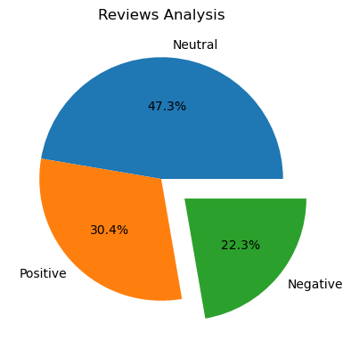
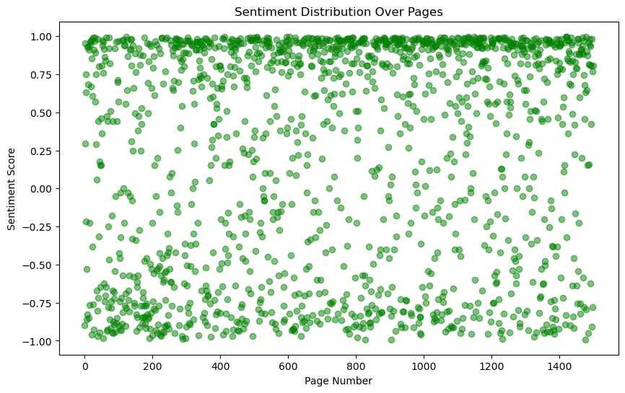
Insights from customer reviews
From cleaning 3740 reviews given by the customers, we obtained
Neutral Reviews – 1770
Positive Reviews - 1137
Negative Reviews - 833

Slide 4
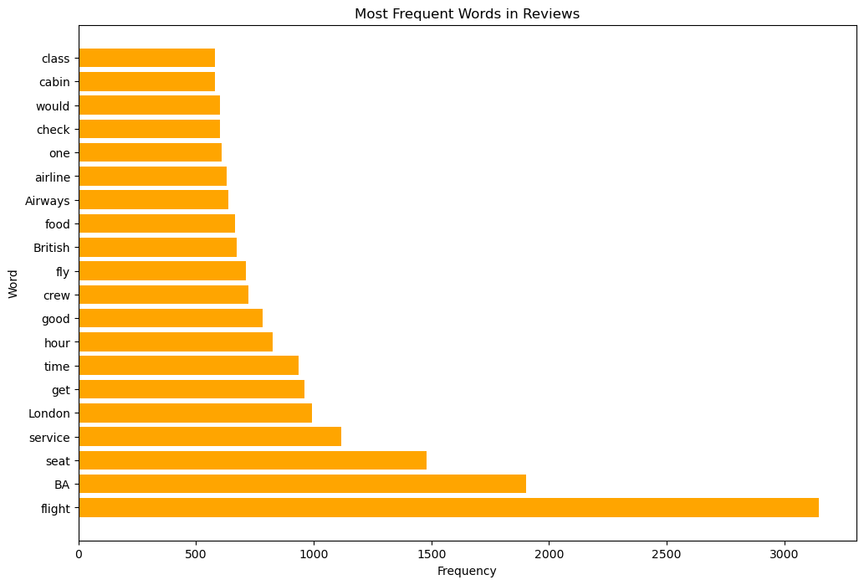
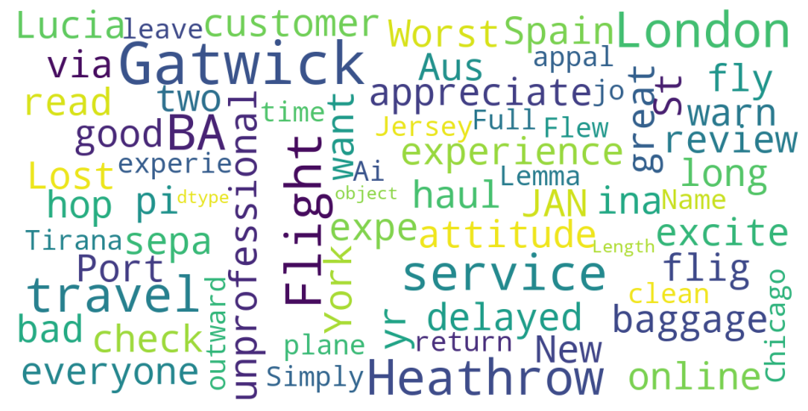
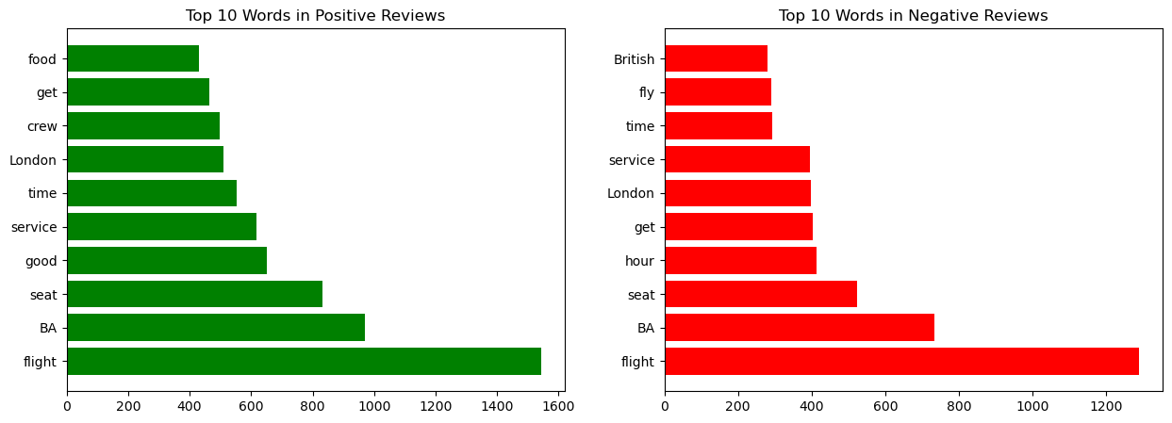
Insights from word cloud

